Slide 1
Using K-means Clustering to Determine Location for New Coffee Shop
Charles Riebeling

Slide 2
Problem Statement
A client wishes to find the best location for a new coffee shop in DC.
She is open to purchasing a storefront in any neighborhood, but does not wish to open the shop in Maryland or Virginia.

Slide 3
Data Sources
The data sources used for this project come from the Foursquare API and from Open Data DC.
Open Data DC provides two data sets: DC traffic data from 2015 and DC neighborhood data.
The Foursquare API is called to get information about venues in the locations provided in the DC data sets.

Slide 4
Methodology
The analysis process is as follows:
Read in a shape file of DC neighborhood clusters
Access the centroid of each neighborhood cluster and merge it to the original shape file
Make a GET request to the Foursquare API for the locations of coffee shops near the centroids of each neighborhood cluster
Read in a shape file for DC traffic patterns
Merge the neighborhood, Foursquare, and traffic sets together
Apply k-means clustering to look at similarities and differences between clusters

Slide 5
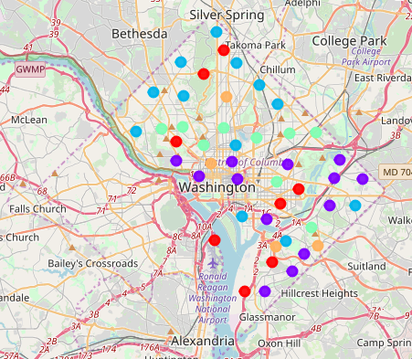
Results
The K-means clustering method split the neighborhoods into five clusters based on how many coffee shops were already in the area and the amount of traffic in each area. The cluster with both the most traffic and the most coffee shops was cluster 4 (orange).

Slide 6
Discussion
Because the traffic in the southeast corner of the city is most likely due to interstate travel between DC, Maryland, and Virginia, the client’s best options are to choose a storefront location near Dupont Circle or in the Petworth area of DC.

Slide 7
Discussion (cont.)
Foursquare provides access to a count of user check-ins at each location, and this data could greatly enhance the analysis by showing the client what types of coffee shops are popular in certain areas.

Slide 8
Conclusion
K-means clustering provided a list of neighborhoods in which it would be most beneficial for my client to open a new coffee shop.
Additional data could be used to enhance the clustering method, if necessary.

